Slide 1



Slide 2
RESCOOD
let’s not dump food, rather dump your ex

Slide 3




RESUE RANGERS
Presenters Names
Name 5
Palak Singh
Panna Tyagi
Swati Kashyap
Tanya Goel

Slide 4

Rescood
4
INTRODUCTION
97% for you
3+
2024
Rescood stands for rescue + food, and that’s exactly what our app does—it rescues food from the jaws of wastage! Imagine a restaurant kitchen where fresh tomatoes, creamy cheeses, and fragrant herbs are tragically forgotten, only to meet an untimely end. Rescood steps in as the hero, giving timely reminders about the shelf life of ingredients so they get used in time, saving money, reducing waste, and keeping plates full of fresh, delicious meals. The name captures our mission: to save food, cut down on waste, and create a smarter, more sustainable dining industry. With Rescood, every ingredient gets a chance to shine on the plate instead of the trash bin!
Next

Slide 5
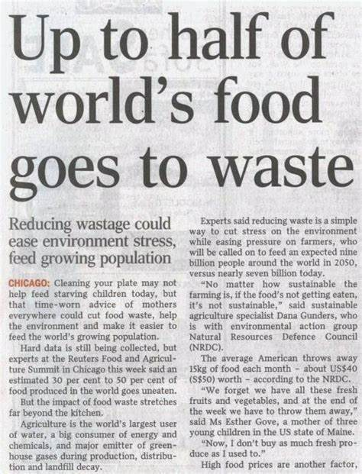
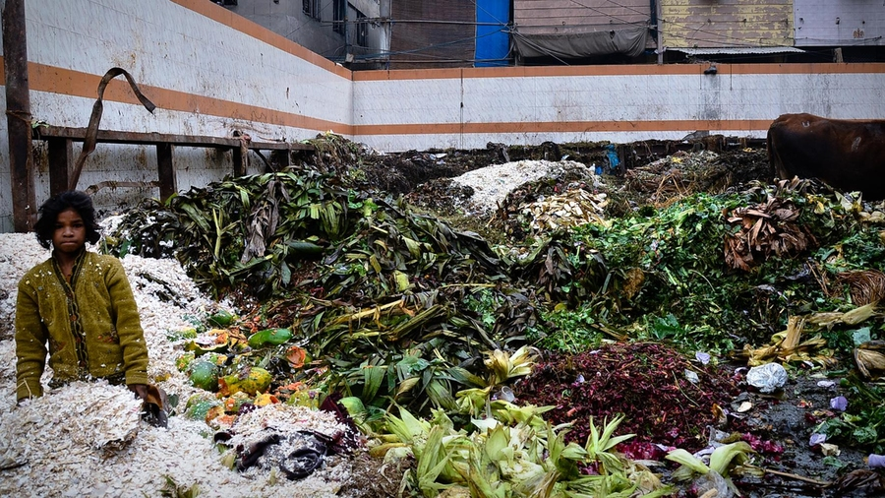
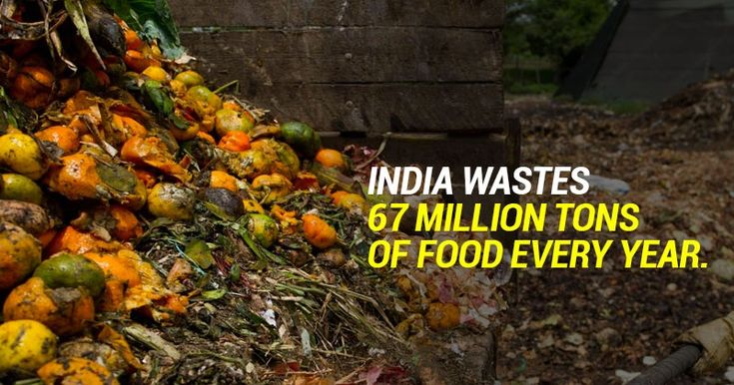

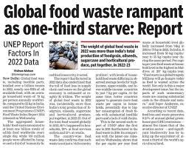
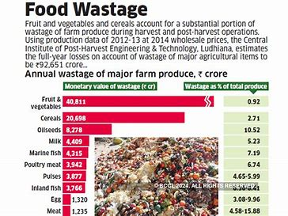
The Problen
Subtitle | English
Next

Slide 6
The Problem
Subtitle | English
The Global Food Waste Problem
Every year, nearly 1.3 billion tons of food is wasted globally. This staggering amount could feed billions of people. Yet, while one part of the world throws away perfectly edible food, another struggles with poverty and hunger.
The Forgotten Feast
Step into a restaurant kitchen, and you'll find dishes chilling in refrigerators, waiting to be served. But what happens when those dishes are forgotten? They sit, expire, and eventually get dumped into the trash—like a sad food farewell party no one attended.
This isn’t just wasted food; it’s wasted effort, money, and resources, all while millions go hungry. And let’s not forget the rotting leftovers contributing to environmental harm.
That’s where 'Rescood' steps in—a timely reminder that food deserves to be on plates, not in dumpsters.
Next

Slide 7
Innovation
Subtitle | English
The Idea Behind Rescood
At its core, Rescood is about turning food management into a smart, sustainable process. The app tackles food wastage in two ways:
Shelf-Life Reminders: Rescood keeps a vigilant eye on all dishes stored in the fridge, sending timely reminders about their shelf life. This ensures food is used before it expires, reducing waste and saving costs for restaurants.
Statistical Insights: Rescood The app also provides a detailed overview of last year's monthly stock data. By analyzing patterns—like which ingredients were overstocked or underused—restaurants can make informed purchasing decisions, streamline operations, and avoid over-ordering.
Next

Slide 8
Our Solution: Smarter Choices, Less Waste
Subtitle | English
Introducing Rescood
Monitor Food Freshness: Tracks real-time freshness of ingredients to avoid spoilage.
Predict Shelf Life: Uses smart algorithms to predict when food will expire, reducing guesswork.
Analyze Sales Data: Identifies sales trends to help optimize purchasing decisions.
Inventory Optimization: Ensures the right balance—neither too much nor too little stock.
Data-Driven Insights: Empowers restaurants to make smarter decisions saving money and the
environment
Why It Matters?
✅ Reduce Food Waste: Save thousands of meals from ending up in landfills. ending up in landfills. ✅ Save Money: Cut down on unnecessary inventory and maximize profits. ✅ Sustainability: Join the fight against environmental harm caused by food waste.
Next

Slide 9
Rescood
4
"Rescood turns chaos into clarity—
managing food shelf life effortlessly to reduce waste and maximize savings."
How it Works?
1 2 3 4
Track Expiry
The App Analyses and Monitors Expiry Dates
Get Alerts
Receive notifications for Dishes expiring soon
Reduce Waste
Act on alerts to save food and cut costs
Add Dishes
Enter The dish name and it’s shelf Life
Next

Slide 10
Technical Approach
Subtitle | English
Core Technologies Used
Python for coding logic and analysis.
Libraries like Pandas, NumPy, Matplotlib, and Seaborn for data manipulation and visualization.
DateTime for shelf-life tracking and expiry predictions
Work Flow
Real-time data tracking for dishes' preparation and expiry times.
Alerts for dishes nearing expiry to minimize food waste.
Statistical insights derived from historical data to optimize inventory and reduce wastage..
Platfrom Integration
Developed using Idle Python.
Code available on GitHub for easy access.
Next

Slide 11
Research and References
Subtitle | English
AI and Coding Help
Open AI
Google AI
Data Sources
Newspaper Reports
TV News Channels
Online Resources
Next

Slide 12
Thank you

